Slide 1
Black Hole Astrophysics Chapters Ch13.1~13.1.2.2
All figures extracted from online sources of from the textbook.

Slide 2
A word of notice
As I have skipped chapters 9.5~12, when the title of the slide contains “was already discussed (in the book)” most likely it is something that I skipped!
Also, this is the first time I studied any of these materials so please correct me if you find anything that I say defying logic.

Slide 3
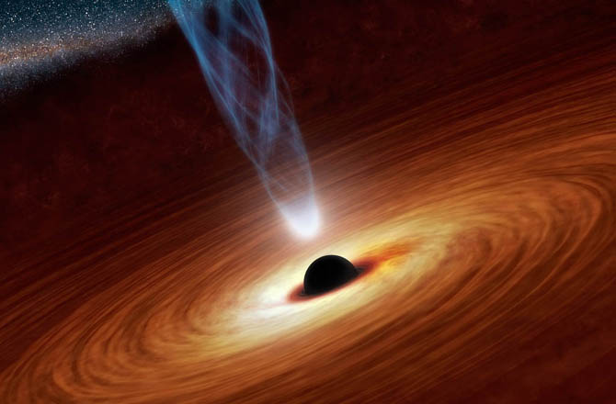
The five exhaust systems
Winds and jets of nonthermal particles driven by a magnetic turbine up to ~0.99c
As was explained a few weeks ago, there are 5 exhaust systems that remove matter/energy from the BH combustion chamber.
Thermal wind up to ~0.1c
Emitted light
Advection of plasma and heat into BH
Viscous Transport of angular momentum outward in disk

Slide 4
What was already discussed (in the book)
Photons produced by viscous heating removes heat and binding energy from the fuel and keeps it at low temperature so it doesn’t explode out of the accretion disk combustion chamber.
Emitted light

Slide 5
What was already discussed (in the book)
Viscous transport of angular momentum via the Magneto-Rotational Instability (MRI) removes angular momentum from the material close to the BH thus allows them to sink further in and generate more energy.
Viscous Transport of angular momentum outward in disk

Slide 6
What was already discussed (in the book)
Material (and heat) that has sunk into the hole becomes part of the BH and no longer has an effect the workings of the BH engine. The only thing it does now is to help the BH grow.
Advection of plasma and heat into BH

Slide 7
What is going to be discussed
When the rate of accretion becomes so large that the pressure of radiation becomes important, then radiation-pressure-driven winds help to self-limit the amount of material that is allowed to fall toward the black hole or neutron star.
Thermal wind up to ~0.1c
It can also be done in a steady manner that allows the engine to fuel steadily but at a reduced rate.

Slide 8
What would be discussed
Winds and jets of nonthermal particles driven by a magnetic turbine up to ~0.99c
The last exhaust system also removes angular momentum and involves the complicated action of magnetic fields. It will be discussed in depth in Ch14~Ch15.

Slide 9
Today：Radiation driven winds

Slide 10
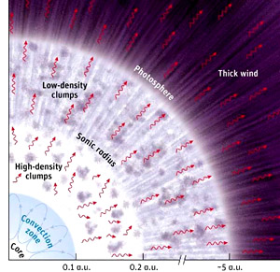
Radiation driven winds - Intro
For radiation to be capable of removing stuff from a system, the easiest way would simply to have the radiation force exceed gravity.
i.e.
$a_{r}^{e−}=\frac{κ_{es}⁢L_{rad}}{4⁢π⁢c⁢r^{2}}≡ℓ_{rad}⁢\frac{GM}{r^{2}}$
$$ℓ_{rad}≥1$$
$L_{rad}$ is the luminosity
$κ_{es}$ electron scattering opacity
$ℓ_{rad}$ the Eddington ratio

Slide 11
Radiation driven winds - Intro
However, it actually isn’t necessary to exceed the Eddington limit for strong winds to develop. With the assistance of bound-bound (line) absorption, we can have matter being accelerated outward by radiation that is sub-Eddington
$$a_{r}^{lines}=\frac{κ_{lines}⁢L_{rad}}{4⁢π⁢c⁢r^{2}}≡\left(1+ℳ\right)⁢ℓ_{rad}⁢\frac{GM}{r^{2}}≥\frac{GM}{r^{2}}$$
$1+ℳ$, the force multiplier is due to additional acceleration from line absorption. Or simply
$1+ℳ=\frac{momentum ⁢transfer⁢ by ⁢line⁢ absorption}{momentum ⁢transfer ⁢by ⁢scattering}$
The same process occurs in massive star atmospheres, and line opacity-driven winds are believed to be the cause of strong outflows emanating from O and B stars. They likely will play a role in black hole engines as well.

Slide 12
Model by Murray and Chiang
A bit of history:
Several models have been proposed for line-driven winds from black hole accretion disks. One model that potentially can explain both the broad emission and absorption lines seen in quasars and Seyfert nuclei was developed in 1995 by Norman Murray, James Chiang, and their colleagues.
BAD SLIDE

Slide 13
The wind launch radius
$$R_{ℳ}$$
At a radius $R_{ℳ}$ where the surface temperature of the disk is cool enough to have partially-ionized atoms $T_{∗}≃{10}^{4−5}⁢K$, the atomic line absorption opacity will be large enough to give a large force multiplier $ℳ$.
An equation (some model for disk temperature) from previous chapters gives this radius:
$$R_{ℳ}=\left(5000\sim {10}^{5}\right)⁢r_{g}⁢m^{−0.25}⁢{\overset{.}{m}}^{0.25}≈\left(7.5×{10}^{8}\sim 1.5×{10}^{10}\right)⁢m^{0.75}⁢{\overset{.}{m}}^{0.25}⁢cm$$
Object | Radius $R_{ℳ}$ (cm)
$1.4 M_{⊙}$ Neutron Star | $$5×{10}^{9}$$
${10}^{9}⁢M_{⊙}$ Black Hole | $$2×{10}^{16}\sim 100r_{g}$$

Slide 14
Adiabatic Wind
Mass Conservation
$$\frac{d}{dr}⁢\left(4⁢{πr}^{2}⁢ρv\right)=0→\frac{2}{r}+\frac{1}{ρ}⁢\frac{dρ}{dr}+\frac{1}{v}⁢\frac{dv}{dr}=0 →\frac{1}{ρ}⁢\frac{dρ}{dr}=−\left(\frac{2}{r}+\frac{1}{v}⁢\frac{dv}{dr}\right)$$
Momentum Equation
$$v⁢\frac{dv}{dr}=−\frac{1}{ρ}⁢\frac{dp}{dr}−\frac{GM}{r^{2}}$$
Adiabatic E.O.S.
$$p=K⁢ρ^{γ}→\frac{dp}{dr}=K⁢γ⁢ρ^{γ−1}\frac{dρ}{dr}=\frac{γp}{ρ} \frac{dρ}{dr}=c_{s}^{2}\frac{dρ}{dr}$$
$$v⁢\frac{dv}{dr}=−\frac{1}{ρ}⁢\frac{dp}{dr}−\frac{GM}{r^{2}}=−c_{s}^{2}\left(\frac{1}{ρ} \frac{dρ}{dr}\right)−\frac{GM}{r^{2}}=c_{s}^{2}\left(\frac{2}{r}+\frac{1}{v}⁢\frac{dv}{dr}\right)−\frac{GM}{r^{2}}$$
$$\left(v^{2}−c_{s}^{2}\right)⁢\frac{r}{v}⁢\frac{dv}{dr}=\left(2⁢c_{s}^{2}−\frac{GM}{r}\right)$$
$$\frac{d⁢ℓn⁢\left(v\right)}{d⁢ℓn⁢\left(r\right)}=−\left(\frac{{GM}/r−2⁢c_{s}^{2}}{v^{2}−c_{s}^{2}}\right)$$

Slide 15
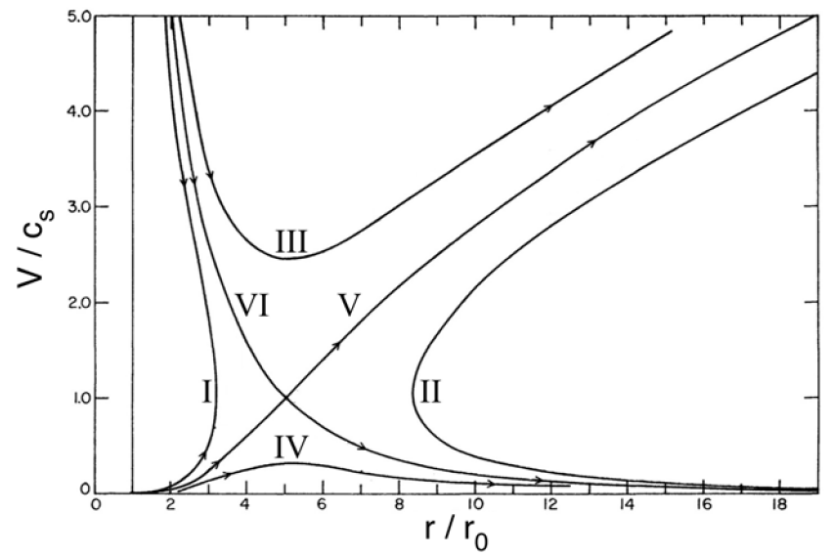
Adiabatic Wind
$$\left(v^{2}−c_{s}^{2}\right)⁢\frac{r}{v}⁢\frac{dv}{dr}=\left(2⁢c_{s}^{2}−\frac{GM}{r}\right)$$
$$v_{c}={± c}_{s}⁢ at ⁢r_{c}=\frac{GM}{2⁢c_{s}^{2}}$$
$$v_{c}$$
$$⁢r_{c}$$

Slide 16
Adiabatic Wind
Mass Conservation
$$\frac{d}{dr}⁢\left(4⁢{πr}^{2}⁢ρv\right)=0→\frac{2}{r}+\frac{1}{ρ}⁢\frac{dρ}{dr}+\frac{1}{v}⁢\frac{dv}{dr}=0 →\frac{1}{ρ}⁢\frac{dρ}{dr}=−\left(\frac{2}{r}+\frac{1}{v}⁢\frac{dv}{dr}\right)$$
Momentum Equation
$$v⁢\frac{dv}{dr}=−\frac{1}{ρ}⁢\frac{dp}{dr}−\frac{GM}{r^{2}}$$
Adiabatic E.O.S.
$$p=K⁢ρ^{γ}→\frac{dp}{dr}=K⁢γ⁢ρ^{γ−1}\frac{dρ}{dr}=\frac{γp}{ρ} \frac{dρ}{dr}=c_{s}^{2}\frac{dρ}{dr}$$
$$v⁢\frac{dv}{dr}=−\frac{1}{ρ}⁢\frac{dp}{dr}−\frac{GM}{r^{2}}=−c_{s}^{2}\left(\frac{1}{ρ} \frac{dρ}{dr}\right)−\frac{GM}{r^{2}}=c_{s}^{2}\left(\frac{2}{r}+\frac{1}{v}⁢\frac{dv}{dr}\right)−\frac{GM}{r^{2}}$$
$$\left(v^{2}−c_{s}^{2}\right)⁢\frac{r}{v}⁢\frac{dv}{dr}=\left(2⁢c_{s}^{2}−\frac{GM}{r}\right)$$
$$\frac{d⁢ℓn⁢\left(v\right)}{d⁢ℓn⁢\left(r\right)}=−\left(\frac{{GM}/r−2⁢c_{s}^{2}}{v^{2}−c_{s}^{2}}\right)$$

Slide 17
Radiation (line) driven wind
Mass Conservation
$$\frac{d}{dr}⁢\left(4⁢{πr}^{2}⁢ρv\right)=0→\frac{2}{r}+\frac{1}{ρ}⁢\frac{dρ}{dr}+\frac{1}{v}⁢\frac{dv}{dr}=0 →\frac{1}{ρ}⁢\frac{dρ}{dr}=−\left(\frac{2}{r}+\frac{1}{v}⁢\frac{dv}{dr}\right)$$
Momentum Equation
$$v⁢\frac{dv}{dr}=−\frac{1}{ρ}⁢\frac{{dp}_{g}}{dr}−\frac{GM}{r^{2}}+\left(1+ℳ\right)⁢ℓ_{rad}⁢\frac{GM}{r^{2}}=−\frac{1}{ρ}⁢\frac{{dp}_{g}}{dr}−\left(1−\left(1+ℳ\right)⁢ℓ_{rad}\right)⁢\frac{GM}{r^{2}}$$
Energy Equation
Implicitly, above assumes $\frac{1}{r^{2}}⁢\frac{d⁢\left(r^{2}⁢H_{r}\right)}{dr}=0$
Generally, assuming $p_{g}=a^{2}⁢ρ$, $\frac{1}{ρ}⁢\frac{{dp}_{g}}{dr}=\frac{1}{ρ}⁢\frac{{dp}_{g}}{dr}=\frac{a^{2}}{ρ}⁢\frac{dρ}{dr}+\frac{{da}^{2}}{dr}$
Extra term
$$v⁢\frac{dv}{dr}=a^{2}⁢\left(\frac{2}{r}+\frac{1}{v}⁢\frac{dv}{dr}\right)−\frac{{da}^{2}}{dr}−\left(1−\left(1+ℳ\right)⁢ℓ_{rad}\right)⁢\frac{GM}{r^{2}}$$
$$\left(v^{2}−a^{2}\right)⁢\frac{r}{v}⁢\frac{dv}{dr}=\left(2a^{2}−\frac{1}{r}\frac{{da}^{2}}{dr}−\left(1−\left(1+ℳ\right)⁢ℓ_{rad}\right)⁢\frac{GM}{r}\right)$$
$$\frac{d⁢ℓn⁢\left(v\right)}{d⁢ℓn⁢\left(r\right)}=−\left(\frac{\left(1−\left(1+ℳ\right)⁢ℓ_{rad}\right)⁢{GM}/r−2⁢a^{2}+{{da}^{2}}/{dℓn}⁢\left(r\right)}{v^{2}−a^{2}}\right)$$

Slide 18
Line driven disk wind equation
Line driven disk wind equation
Basic wind equation
$$\frac{d⁢ℓn⁢\left(V\right)}{d⁢ℓn⁢\left(r\right)}=−\left\{\frac{1−\left[\left(1+ℳ\right)⁢{\overset{\sim }{ℓ}}_{rad}\right]⁢\left(\frac{f GM}{r}\right)−2⁢a^{2}+\frac{d⁢a^{2}}{d⁢ℓn⁢\left(r\right)}}{v^{2}−a^{2}}\right\}$$
$$\frac{d⁢ℓn⁢\left(V\right)}{d⁢ℓn⁢\left(r\right)}=−\left(\frac{\left(\frac{GM}{r}\right)−2⁢{c_{s}}^{2}}{v^{2}−{c_{s}}^{2}}\right)$$
$a=\sqrt{\frac{p_{g}}{ρ}}$ the isothermal gas pressure. It is the use of ‘a’ instead of $c_{s}$ that adds the gradient term $\frac{d⁢a^{2}}{d⁢ℓn⁢\left(r\right)}$
The Eddington ratio $ℓ_{rad}⁢$ is now replaced by ${\overset{\sim }{ℓ}}_{rad}≡ℓ_{rad}⁢ⅇ^{−τ_{es}}$ to account for disk geometry.
$f≡1−{R_{ℳ}}/r$ causes the wind to start at zero velocity at radius $R_{ℳ}$.
$$R_{ℳ}$$

Slide 19
The singular point for line driven winds
$$\frac{d⁢ℓn⁢\left(V\right)}{d⁢ℓn⁢\left(r\right)}=−\left\{\frac{1−\left[\left(1+ℳ\right)⁢{\overset{\sim }{ℓ}}_{rad}\right]⁢\left(\frac{f GM}{r}\right)−2⁢a^{2}+\frac{d⁢a^{2}}{d⁢ℓn⁢\left(r\right)}}{v^{2}−a^{2}}\right\}$$
The singular point is not at v=a because there are two extra derivatives on the right (if brought over to the left would modify the denominator $v^{2}−a^{2}$ to something else.)
The force multiplier also contains as derivative!
Recall that $1+ℳ=\frac{momentum ⁢transfer⁢ by ⁢line⁢ absorption}{momentum ⁢transfer ⁢by ⁢scattering}$
Thus, $ℳ$ is only large when line absorption is active!
We will explain this on the next few slides.

Slide 20
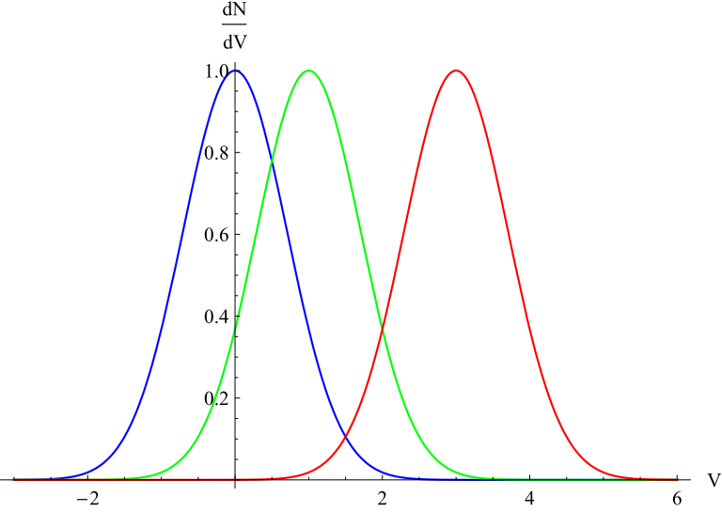
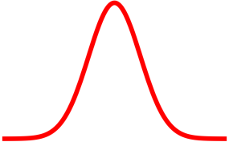
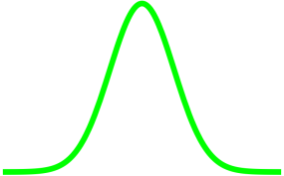
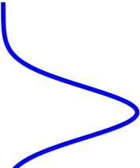
Position dependence of $ℳ$
Since the wind is accelerating, radiation will be Doppler shifted with respect to the atoms in the wind
Let’s consider 3 points along the curve
At different radii, we will have a different central velocity.
$$ΔV≃V_{th}$$
dr
Therefore, we must be in a region (some dr) in which $τ_{L}$ is large for the action to occur. This tells us that $ℳ$ also contains a derivative
$$ℳ⁢\left(τ_{L}\right)=ℳ⁢\left(κ_{L}⁢ρ⁢\frac{V_{th}}{|{dV}/{dr}|}\right)$$

Slide 21
The terminal velocity
The actual terminal velocity obviously depends on the exact functional form of $ℳ$, but a rough approximation can be found to be:
$$v_{∞}≈\sqrt{\frac{4⁢G⁢M}{R_{ℳ}}}$$
And the model seems to work:
Object | $$v_{∞}(km·s^{−1})$$ | Source | Observed Speed ($km·s^{−1}$)
$1.4 M_{⊙}$ Neutron Star | ~3000 | NS X-ray binary Circinus X-1 | 2000
${10}^{9}⁢M_{⊙}$ Black Hole | ~25,000 | Broad Absoprtion Line (BAL) QSOs | 5000~50,000

Slide 22
The X-Ray Heating problem
Accreting NS/BHs are strong X-ray sources with radiation temperature $T_{r}\sim {10}^{8}⁢K$.
Why does a model with accelerated gas being only of ${10}^{4−5}K$ work well?
This X-ray radiation is believed to originate near the center of the accretion disk from a corona above the cooler accretion disk. These hard photons should raise the temperature of the disk surface by Compton scattering the cooler electrons to an equilibrium “Compton” temperature of
$$T_{C}\sim \frac{1}{4}⁢T_{r}≈2.5×{10}^{7}$$
However, the observed winds are nowhere nearly that hot.
Source | Line temperature (K)
NS X-ray binary Circinus X-1 | $$\sim {10}^{6}$$
Broad Absoprtion Line (BAL) QSOs | $$\sim {10}^{4−5}$$

Slide 23
X-ray Heating problem–Explanation 1
Main idea: Shielding gas
Murray and Chiang suggested that cool, dense gas is drawn up from the surface of the disk, just inside the launching point, by the wind itself. This is thought to be accomplished by pressure gradients induced by the wind loss. This “hitchhiking gas” then shields the accelerating outflow from the X-rays but not from the UV photons that are doing the acceleration.

Slide 24
X-ray Heating problem–Explanation 2
Main idea: Shielding gas
Another possibility is that Compton heating of the disk surface interior to $R_{ℳ}$ produces the shielding gas – in the form of a cool corona. That corona would attenuate X-rays from the central source, allowing a wind to be launched from a radius $R_{C}$ (beyond which Compton heating of the surface would be unimportant). $R_{C}$would differ from $R_{ℳ}$ , of course, and it is not known at this time whether this would give as successful a model as the standard Murray and Chiang model.

Slide 25
X-ray Heating problem–Explanation 3
Main idea: State transition
The presence of strong Compton-heating X-ray emission comes from the assumption that sources that show winds are simply normal objects, viewed along the surface of the disk. A third possibility, however, is that Cir X-1 and BAL QSOs are not like other X-ray sources and quasars.
Indeed, they are thought to be radiating very close to the Eddington limit $(ℓ_{rad}>0.5)$, whereas quasars are thought to be somewhat less luminous $(ℓ_{rad}\sim 0.1)$
When $\overset{.}{m}→1$, the accretion flow may enter a cooler, optically thick, advectively-cooled “slim” disk state. That is, the inner hot corona that normally produces the X-rays may be quenched by the geometrically thick inflow. This would leave only the cooler disk accretion itself, implying central temperatures from equation (12.52) of ∼ ${10}^{7}$K for Cir X-1 and ∼ ${10}^{5}$K for BAL QSOs.

Slide 26
X-ray Heating problem–Explanation 4
Main idea: The outflow is not line-driven!
In Section 16.4.1 we suggest yet another explanation: the outflow is not line-driven at all but, rather, an advection-dominated inflow–outflow solution (ADIOS) wind, driven by thermal pressure of the hot component in the two-phase medium that may develop in the unstable Shakura–Sunyaev “inner” disk region (Section 12.2.2). (ADIOS winds will be discussed later in this chapter in Section 13.2.)
Again, it is the cool component that hitchhikes with the hot component, and it is lifted off the surface of the inflow by pressure gradients, but the latter develop simply because the ADIOS outflow is naturally unbounded to begin with.

Slide 27
Continuum-Driven, Super-Eddington Winds (Ch13.1.2)

Slide 28
Continuum-Driven, Super-Eddington Winds Introduction
When the disk accretion rate exceeds the Eddington limit ($\overset{.}{m}>1$), then the wind takes on quite a different character.
Instead of being driven from the surface of the disk “middle” or “outer” region, the radiation force on the electrons in the “inner” disk alone potentially can exceed gravity $(ℓ_{rad}>1)$. The “inner” region of the disk puffs up into a thick, radiation-pressure-supported, toroidal (almost spherical) structure.

Slide 29
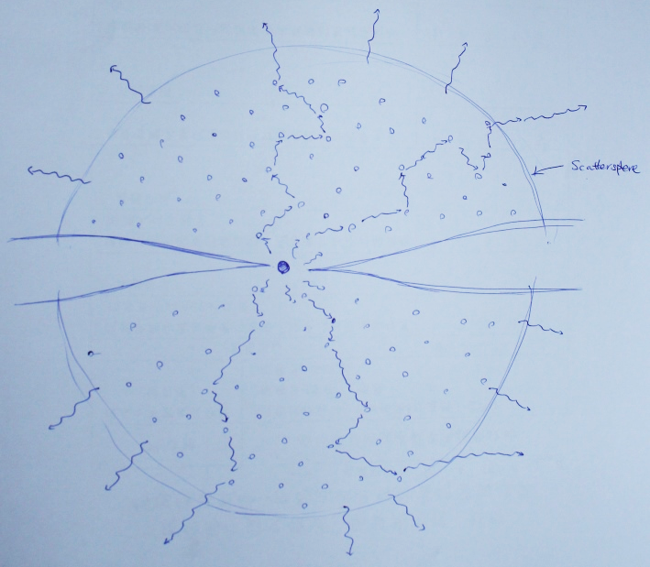
Continuum-Driven, Super-Eddington Winds Introduction
If the luminosity generated exceeds $L_{Edd}$, an optically thick, essentially spherical wind will be driven from the disk “inner” region.
Generally the wind will be so dense that, even for moderately high super-Eddington accretion rates ($\overset{.}{m}=10\sim 100$), the surface of last scattering or “scattersphere” will be at a radius of ${10}^{3−5}⁢r_{g}$. This wind, therefore, could sometimes engulf a large fraction of the entire accretion disk, making the accreting black hole look more like a luminous nova than an X-ray source.
*Note that the following model mainly follows that developed in the paper by the same author in 1982.

Slide 30
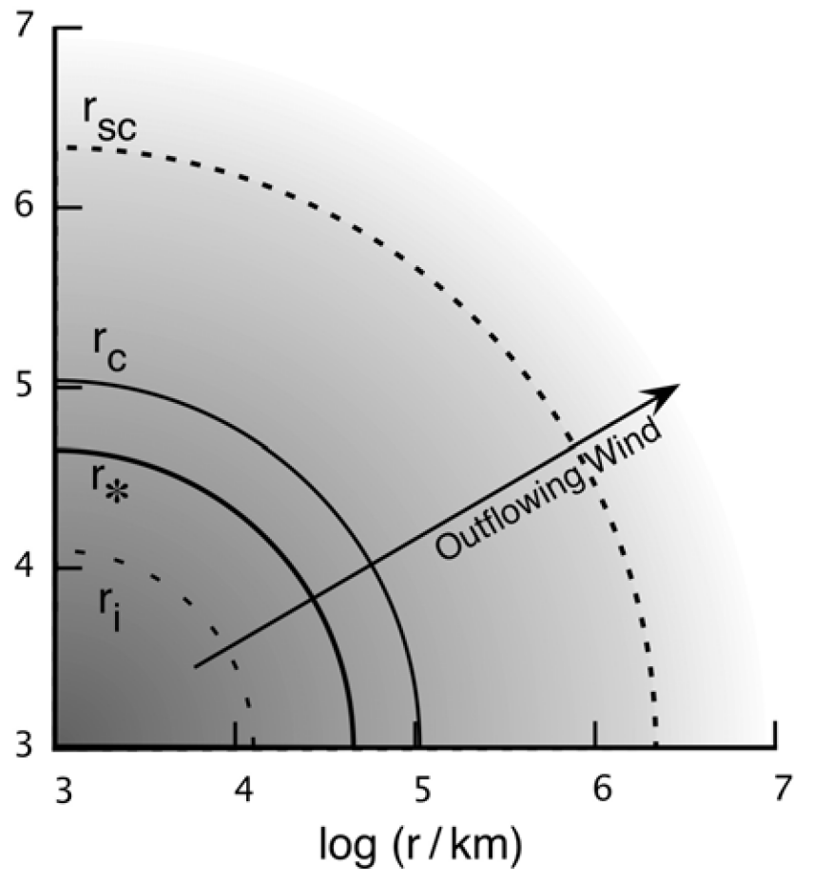
Physical Structure – Intro
The Injection Radius ($r_{i}$):
Near this radius, $r_{i}=8.2×{10}^{5}⁢ m·\overset{.}{m}⁢ cm$ the disk is bloated by radiation pressure.
In our model we will assume that all the material exiting the system in the wind is injected at $r_{i}$ , although in reality some of it comes from the region $r<r_{i}$ and perhaps a little beyond as well.
Parameters:
m: black hole mass
$\overset{.}{m}$: normalized accretion rate
$α$: viscosity parameter
α mainly tells how rapidly the gravitational energy released in the accretion flow at $r_{i}$is turned into heat. This ultimately determines the density and wind lift-off velocity at $r_{i}$, and it sets the stage for the ensuing wind structure.

Slide 31
Physical Structure – Intro
The Singular/Critical Radius ($r_{c}$):
Similar to what we described earlier, when the wind passes this point, it becomes supersonic and thus kinetically dominated.
Beyond $r_{c}$ the flow becomes increasingly difficult to accelerate, because its speed is so fast that it leaves the system before dynamical forces have much time to act upon it.
The wind achieves a terminal velocity not much greater than the critical velocity, so $v_{ter}\sim v_{c}$.

Slide 32
Physical Structure – Intro
The Scattersphere Radius ($r_{sc}$):
The wind becomes optically thin to electron scattering at this radius.
Most models that we will describe
here will do so in the supersonic portion of the flow; that is $r_{sc}>r_{c}$.
$r_{∗}$ is the photosphere radius defined to be the surface of last absorption. (The word photosphere to my knowledge is usually used for surface of last scattering or absorption?)
However, as we discussed in previous weeks, electron scattering dominates in accretion disks and therefore $r_{∗}<r_{sc}$.

Slide 33
Basic Equations
Even though there may be some initial departure from spherical symmetry near the injection region, generally the wind will be spherically symmetric throughout most of its structure. Considering non-relativistic winds, we have the following equations:
$\frac{1}{r^{2}}⁢\frac{d⁢\left(r^{2}⁢ρ⁢v\right)}{dr}=0$ Mass continuity
$v⁢\frac{dv}{dr}=−\frac{G⁢M}{r^{2}}−\frac{1}{ρ}⁢\frac{{dp}_{g}}{dr}+\frac{κ_{es}⁢H_{r}}{c}$ Momentum equation
Recall $a_{r}^{lines}=\frac{κ_{lines}⁢L_{rad}}{4⁢π⁢c⁢r^{2}}$
$v⁢\frac{dε}{dr}+\frac{\left(p+ε\right)}{r^{2}}⁢\frac{d⁢\left(r^{2}⁢v\right)}{dr}=−\frac{1}{r^{2}}⁢\frac{d⁢\left(r^{2}⁢H_{r}\right)}{dr}+ρ⁢\overset{.}{q}$ Energy equation
v: The outward wind velocity
$ε=ε_{r}+ε_{g}≈ε_{r}$: the energy density of the wind (dominated by photons)
$p=p_{r}+p_{g}≈p_{r}$ : pressure of the wind (also dominated by photons)
$H_{r}={L_{rad}}/4⁢{πr}^{2}$: outward flux of radiation
$ε≈3⁢p$ : Relation for photons

Slide 34
The injection region
$ρ⁢\overset{.}{q}=\left\{\begin{matrix}α⁢\frac{\left(p+ε\right)}{τ_{dyn}} & r≤r_{i} \\ 0 & r>r_{i}\end{matrix}\right.$
$L_{T}≡\int{4⁢{πr}^{2}⁢ρ⁢\overset{.}{q}⁢dr}≈4⁢{{πr}_{i}}^{3}⁢α⁢\frac{\left(p+ε\right)}{τ_{dyn}}$
$\frac{1}{r^{2}}⁢\frac{d⁢\left(r^{2}⁢ρ⁢v\right)}{dr}=0→Δ⁢\overset{.}{M}≡4⁢{{πr}_{i}}^{2}⁢ρ_{i}⁢v_{i}$
$v⁢\frac{dv}{dr}=−\frac{G⁢M}{r^{2}}−\frac{1}{ρ}⁢\frac{{dp}_{g}}{dr}+\frac{κ_{es}⁢H_{r}}{c}→L_{rad}=\left(1−\frac{p_{g}}{p}\right)⁢L_{Edd}$
$v⁢\frac{dε}{dr}+\frac{\left(p+ε\right)}{r^{2}}⁢\frac{d⁢\left(r^{2}⁢v\right)}{dr}=−\frac{1}{r^{2}}⁢\frac{d⁢\left(r^{2}⁢H_{r}\right)}{dr}+ρ⁢\overset{.}{q}→Δ⁢\overset{.}{M}⁢\left(\frac{p+ε}{ρ}\right)=L_{T}−L_{rad}$
If $L_{rad}$ is close to $L_{Edd}$, $Δ⁢\overset{.}{M}=(L_{T}−L_{rad})⁢\left(\frac{ρ}{p+ε}\right)$
the wind mass-loss rate is just enough to carry off the remaining enthalpy generated above the Eddington luminosity

Slide 35
Diffusion approximation $H_{r}=\frac{−c}{{ρκ}_{es}}⁢\frac{{dp}_{r}}{dr}$
Within the region where it is optically thick for photons ($r<r_{sc}$), we can use the following diffusion approximation:
$$r_{sc}⁢\left(τ_{es}≈1\right)$$
This then modifies the momentum equation to $v⁢\frac{dv}{dr}=−\frac{G⁢M}{r^{2}}−\frac{1}{ρ}⁢\frac{{dp}_{g}}{dr}+\frac{κ_{es}⁢H_{r}}{c}=−\frac{G⁢M}{r^{2}}−\frac{1}{ρ}⁢\frac{dp}{dr}$
This gives, approximately $\frac{p}{ρ}≈\frac{G⁢M}{4⁢r}$
HOW!?
$Δ⁢\overset{.}{M}=(L_{T}−L_{rad})⁢\left(\frac{ρ}{p+ε}\right)=\frac{4⁢{πcr}_{i}}{κ_{es}}⁢\left(\frac{L_{T}}{L_{Edd}}−1\right)≡\overset{.}{M}⁢\left(\frac{L_{T}}{L_{Edd}}−1\right)$

Slide 36
The total accreted mass $\overset{.}{M}$
For simplicity, we consider only two parts: (below is only for illustration, remember that it’s optically thick so most likely you aren’t seeing any of this and it’s spherical…)
1. Matter that falls in to $r_{i}$ then is blown off $Δ⁢\overset{.}{M}$ (releases $\left({GM}/{r_{i}}\right)⁢Δ⁢\overset{.}{M}$ of potential energy)
2. Matter that falls into the hole $δ⁢\overset{.}{M}$ (energy released $ε_{acc}⁢δ⁢\overset{.}{M}⁢c^{2}$)
Simple relation:
$$\overset{.}{M}=δ⁢\overset{.}{M}+Δ⁢\overset{.}{M}$$
Super Eddington wind
Total Luminosity that is released is thus:
$$L_{T}=ε_{acc}⁢δ⁢\overset{.}{M}⁢c^{2}+\frac{GM}{r^{i}}⁢Δ⁢\overset{.}{M}$$
$$r_{i}$$
Advection of plasma and heat into BH

Slide 37
Two possible solutions
$$Δ⁢\overset{.}{M}≡\overset{.}{M}⁢\left(\frac{L_{T}}{L_{Edd}}−1\right)$$
$$L_{T}=ε_{acc}⁢δ⁢\overset{.}{M}⁢c^{2}+\frac{GM}{r^{i}}⁢Δ⁢\overset{.}{M}$$
$$\overset{.}{M}=δ⁢\overset{.}{M}+Δ⁢\overset{.}{M}$$
 | No-wind solution | Super-Eddington wind solution
$$L_{T}$$ | $$ε_{acc}⁢δ⁢\overset{.}{M}⁢c^{2}$$ | $\left(1+\frac{r_{g}}{ε_{acc}⁢r_{i}}⁢\left(\overset{.}{m}−1\right)\right)⁢L_{Edd}=\left(2−\frac{1}{\overset{.}{m}}\right)⁢L_{Edd}$
$$Δ⁢\overset{.}{M}$$ | 0 | $\overset{.}{M}−{\overset{.}{M}}_{Edd}$
$$δ⁢\overset{.}{M}$$ | $$\overset{.}{M}$$ | ${\overset{.}{M}}_{Edd}$

Slide 38
The Wind Structure
Solving the following equations, for the conditions explained below, we can get the following limiting cases (I will not explain the derivation as it took a whole afternoon…)
$$\frac{1}{r^{2}}⁢\frac{d⁢\left(r^{2}⁢ρ⁢v\right)}{dr}=0$$
$$v⁢\frac{dv}{dr}=−\frac{G⁢M}{r^{2}}−\frac{1}{ρ}⁢\frac{dp}{dr}$$
$$v⁢\frac{dε}{dr}+\frac{\left(p+ε\right)}{r^{2}}⁢\frac{d⁢\left(r^{2}⁢v\right)}{dr}=−\frac{1}{r^{2}}⁢\frac{d⁢\left(r^{2}⁢H_{r}\right)}{dr}+ρ⁢\overset{.}{q}$$
Region | $$r<r_{c}$$ | $$r>r_{c}$$
Approximation | $$v⁢ ≪c_{s}$$ | $$v⁢\frac{dv}{dr}≈0$$
Argument | When the wind has just been launched, it is still way below the (total) sound speed. | (Far?) Beyond the critical point, the inertial terms dominate and the wind is no longer accerated.
$$ρ$$ | $ρ_{i}⁢{\left(\frac{r}{r_{i}}\right)}^{−3}$ | $$ρ_{c}⁢{\left(\frac{r}{r_{c}}\right)}^{−2}=ρ_{i}⁢ζ^{−3}⁢{\left(\frac{r}{r_{c}}\right)}^{−2}$$
$$v$$ | $v_{i}⁢\left(\frac{r}{r_{i}}\right)$ | $$v_{c}=v_{i}⁢ ζ$$
$$p$$ | $p_{i}⁢{\left(\frac{r}{r_{i}}\right)}^{−4}$ | $p_{c}⁢{\left(\frac{r}{r_{c}}\right)}^{−3}=p_{i}⁢ζ^{−4}⁢{\left(\frac{r}{r_{c}}\right)}^{−3}$
$$ζ≡\frac{r_{c}}{r_{i}}$$
← I can’t get this..

Slide 39
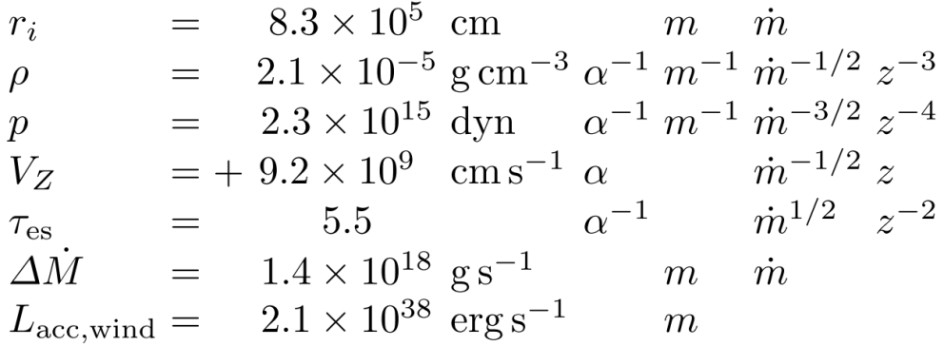
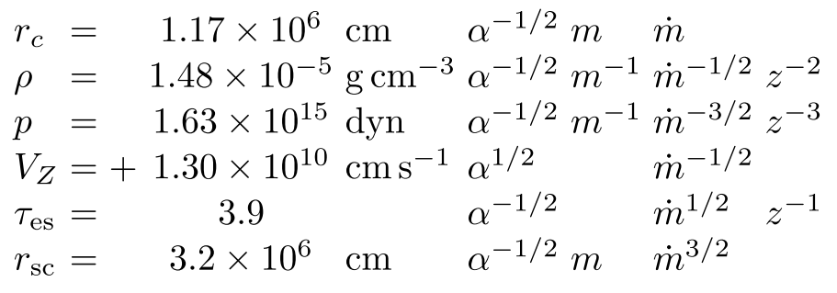
Along with the previously derived parameters, the following numerical values could be found (at least so says the book…, I didn’t have time to work them out)
 | No-wind solution | Super-Eddington wind solution
$$L_{T}$$ | $$ε_{acc}⁢δ⁢\overset{.}{M}⁢c^{2}$$ | $\left(1+\frac{r_{g}}{ε_{acc}⁢r_{i}}⁢\left(\overset{.}{m}−1\right)\right)⁢L_{Edd}=\left(2−\frac{1}{\overset{.}{m}}\right)⁢L_{Edd}$
$$Δ⁢\overset{.}{M}$$ | 0 | $\overset{.}{M}−{\overset{.}{M}}_{Edd}$
$$δ⁢\overset{.}{M}$$ | $$\overset{.}{M}$$ | ${\overset{.}{M}}_{Edd}$
 | $$ρ$$ | $$v$$ | $$p$$
$$r<r_{c}$$ | $ρ_{i}⁢{\left(\frac{r}{r_{i}}\right)}^{−3}$ | $v_{i}⁢\left(\frac{r}{r_{i}}\right)$ | $p_{i}⁢{\left(\frac{r}{r_{i}}\right)}^{−4}$
$$r>r_{c}$$ | $ρ_{c}⁢{\left(\frac{r}{r_{c}}\right)}^{−2}=ρ_{i}⁢ζ^{−3}⁢{\left(\frac{r}{r_{c}}\right)}^{−2}$ | $$v_{c}=v_{i}⁢ζ$$ | $p_{c}⁢{\left(\frac{r}{r_{c}}\right)}^{−3}=p_{i}⁢ζ^{−4}⁢{\left(\frac{r}{r_{c}}\right)}^{−3}$
$$r<r_{c}$$
$$r>r_{c}$$

Slide 40
Now, it’s critical to find where the critical point ($r_{c}$) is!
Before we can go into this, we need to first look at two (again, limiting) cases of the energy equation as it will affect how the critical point should be determined!
The energy equation $v⁢\frac{dε}{dr}+\frac{\left(p+ε\right)}{r^{2}}⁢\frac{d⁢\left(r^{2}⁢v\right)}{dr}=−\frac{1}{r^{2}}⁢\frac{d⁢\left(r^{2}⁢H_{r}\right)}{dr}$
There can be two extremes as listed below:
 | Radiative | Adiabatic
Basic Equation | $$\frac{1}{r^{2}}⁢\frac{d⁢\left(r^{2}⁢H_{r}\right)}{dr}=0$$ | $$v⁢\frac{dε}{dr}+\frac{\left(p+ε\right)}{r^{2}}⁢\frac{d⁢\left(r^{2}⁢v\right)}{dr}=0$$
Explanation | Photon diffusion dominates over the force of electrons trying to drag the photons along adiabatically | The photons are dragged along with the electrons therefore there is no net flux between different radii
$$\frac{d⁢ℓn⁢\left(V\right)}{d⁢ℓn⁢\left(r\right)}$$ | $−\left(\frac{\left(1−ℓ_{rad}\right)⁢\left(\frac{GM}{r}\right)−2⁢a^{2}+\frac{d⁢a^{2}}{d⁢ℓn⁢\left(r\right)}}{v^{2}−a^{2}}\right)$ | $−\left(\frac{\left(\frac{GM}{r}\right)−2⁢{c_{s}}^{2}}{v^{2}−{c_{s}}^{2}}\right)$
Critical point $r_{c}$ | $r_{s,g}$ (gas pressure sonic point) | $r_{s}$ (total pressure sonic point)
Velocity at $r_{c}$ | $a=\sqrt{\frac{p_{g}}{ρ}}$ | $c_{s}=\sqrt{\frac{γp}{ρ}}$

Slide 41
Radiative or Adiabatic?
Now we are faced with a different problem: The radiative and adiabatic cases have different critical radii.
Therefore it now becomes important to know under what conditions will each be a valid approximation.
The book gives only (again) limiting cases and slices them apart with a very stiff boundary.
The energy equation $v⁢\frac{dε}{dr}+\frac{\left(p+ε\right)}{r^{2}}⁢\frac{d⁢\left(r^{2}⁢v\right)}{dr}=−\frac{1}{r^{2}}⁢\frac{d⁢\left(r^{2}⁢H_{r}\right)}{dr}$
The question: which flux dominates?

Slide 42
Radiative or Adiabatic? (cont’)
The energy equation $v⁢\frac{dε}{dr}+\frac{\left(p+ε\right)}{r^{2}}⁢\frac{d⁢\left(r^{2}⁢v\right)}{dr}=−\frac{1}{r^{2}}⁢\frac{d⁢\left(r^{2}⁢H_{r}\right)}{dr}$
The question: which flux dominates?
The 1st term (Adiabatic dominance):
$$|v⁢\frac{dϵ}{dr}|≈\frac{12⁢v⁢p}{r}$$
The 2nd term (Radiative dominance):
$$|\frac{1}{r^{2}}⁢\frac{d⁢\left(r^{2}⁢H_{r}\right)}{dr}|=|\left.\frac{c}{κ_{es}⁢r^{2}}[\frac{d}{dr}⁢\left(r^{2}⁢v⁢\frac{dv}{dr}\right)+\frac{d}{dr}⁢\left(\frac{r^{2}}{ρ}⁢\frac{{dp}_{g}}{dr}\right)\right]|≈\left\{\begin{matrix}\frac{3⁢c}{κ_{es}⁢r^{2}}⁢a^{2} & v^{2}<a^{2} \\ \frac{3⁢c}{κ_{es}⁢r^{2}}⁢v^{2} & v^{2}>a^{2}\end{matrix}\right.$$
$v⁢\frac{dv}{dr}=−\frac{G⁢M}{r^{2}}−\frac{1}{ρ}⁢\frac{{dp}_{g}}{dr}+\frac{κ_{es}⁢H_{r}}{c}$ The momentum equation
*Note that we can’t plug in the diffusion approximation because we don’t know yet whether this transition is at the optically thin or thick region.

Slide 43
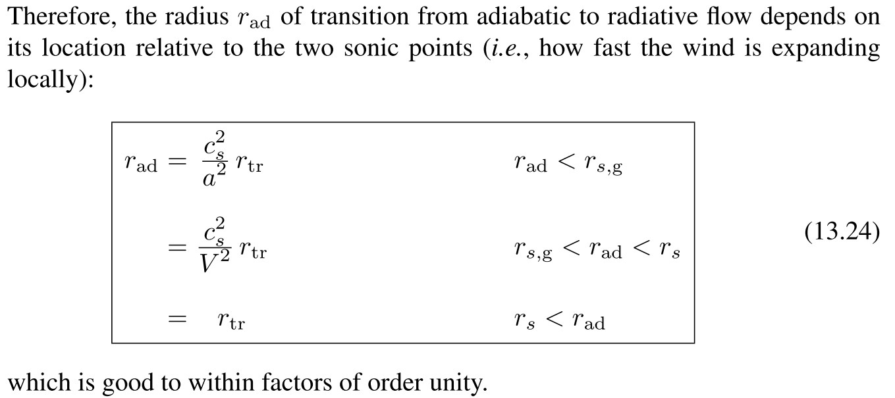
Radiative or Adiabatic? (cont’)
*I see no point in retyping this this I’ll have to read it through anyway…
$r_{tr}$ is the trapping radius introduced earlier in the book but to save time, I won’t introduce it here.
$v⁢\frac{dε}{dr}+\frac{\left(p+ε\right)}{r^{2}}⁢\frac{d⁢\left(r^{2}⁢v\right)}{dr}=0$
$r_{c}{\sim r}_{s} ；v\sim c_{s}=\sqrt{\frac{γp}{ρ}}$
$\frac{1}{r^{2}}⁢\frac{d⁢\left(r^{2}⁢H_{r}\right)}{dr}=0$
$r_{c}{\sim r}_{s,g} ；v\sim a=\sqrt{\frac{p_{g}}{ρ}}$
r
Adiabatic
$$r_{ad}$$
Radiative

Slide 44
Different cases
Optically thin ($r_{c}>r_{sc}$)
Case A ($r_{ad}<r_{sc}$ from book, $r_{ad}<r_{sc}$ from paper… I think the book is mistyped)
Optically thick ($r_{c}<r_{sc}$)
Case B $r_{ad}<r_{s,g}<r_{sc}<r_{s}$
Case C1 $r_{s,g}<r_{ad}<r_{s};r_{ad}<r_{sc}$
Case C2 $r_{sg}<r_{sc}<r_{ad}<r_{s}$
Case D $r_{s}<r_{ad}<r_{sc}$
 | $$ρ$$ | $$v$$ | $$p$$
$$r<r_{c}$$ | $ρ_{i}⁢{\left(\frac{r}{r_{i}}\right)}^{−3}$ | $v_{i}⁢\left(\frac{r}{r_{i}}\right)$ | $p_{i}⁢{\left(\frac{r}{r_{i}}\right)}^{−4}$
$$r>r_{c}$$ | $ρ_{c}⁢{\left(\frac{r}{r_{c}}\right)}^{−2}=ρ_{i}⁢ζ^{−3}⁢{\left(\frac{r}{r_{c}}\right)}^{−2}$ | $$v_{c}=v_{i}⁢ζ$$ | $p_{c}⁢{\left(\frac{r}{r_{c}}\right)}^{−3}=p_{i}⁢ζ^{−4}⁢{\left(\frac{r}{r_{c}}\right)}^{−3}$
$v⁢\frac{dε}{dr}+\frac{\left(p+ε\right)}{r^{2}}⁢\frac{d⁢\left(r^{2}⁢v\right)}{dr}=0$
$r_{c}{\sim r}_{s} ；v\sim c_{s}=\sqrt{\frac{γp}{ρ}}$
$\frac{1}{r^{2}}⁢\frac{d⁢\left(r^{2}⁢H_{r}\right)}{dr}=0$
$r_{c}{\sim r}_{s,g} ；v\sim a=\sqrt{\frac{p_{g}}{ρ}}$
r
Adiabatic
$$r_{ad}$$
Radiative

Slide 45
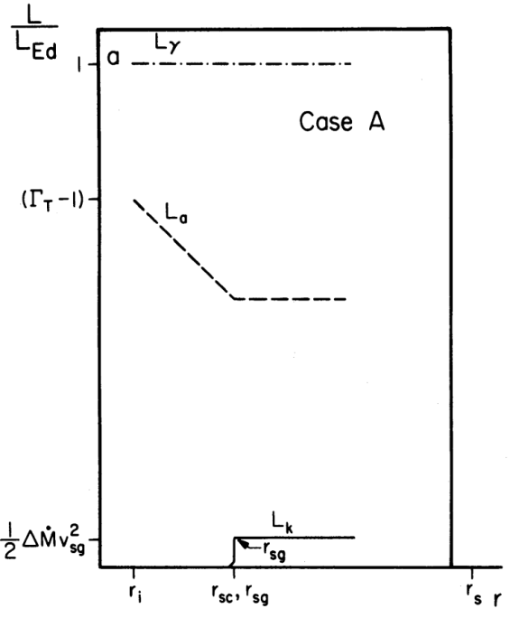
Optically thin Case A ($r_{sc}<r_{sg}$)
The wind reaches an optically thin region $r>r_{sc}$ before it even gets to $r_{s,g}$.
This simply reduces to the case like our early discussion of the line driven wind which gives $v_{ter}\sim a⁢\left(r_{s,g}\right)$
 | $$ρ$$ | $$v$$ | $$p$$
$$r<r_{c}$$ | $ρ_{i}⁢{\left(\frac{r}{r_{i}}\right)}^{−3}$ | $v_{i}⁢\left(\frac{r}{r_{i}}\right)$ | $p_{i}⁢{\left(\frac{r}{r_{i}}\right)}^{−4}$
$$r>r_{c}$$ | $ρ_{c}⁢{\left(\frac{r}{r_{c}}\right)}^{−2}$ | $$v_{c}=v_{i}⁢ζ$$ | $p_{c}⁢{\left(\frac{r}{r_{c}}\right)}^{−3}$
Photon Luminosity
Kinetic Luminosity
Advective Luminosity
WHAT?!
$r_{c}{\sim r}_{s} ；v\sim c_{s}=\sqrt{\frac{γp}{ρ}}$
$r_{c}{\sim r}_{s,g} ；v\sim a=\sqrt{\frac{p_{g}}{ρ}}$
r
Adiabatic
$$r_{ad}$$
Radiative

Slide 46
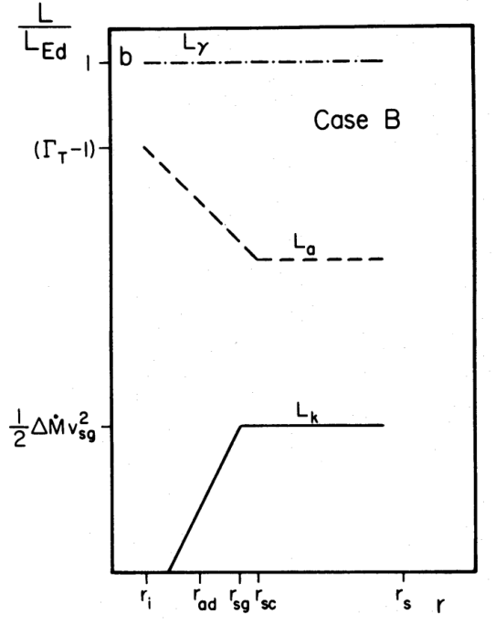
Optically Thick Case B $(r_{ad}<r_{s,g}<r_{sc}<r_{s})$
$r_{ad}$ being smallest tells us that we are in the radiative zone. Therefore the flow will accelerate to around the gas pressure sonic point $r_{s,g}$. Giving $v_{ter}\sim a⁢\left(r_{s,g}\right)$
 | $$ρ$$ | $$v$$ | $$p$$
$$r<r_{c}$$ | $ρ_{i}⁢{\left(\frac{r}{r_{i}}\right)}^{−3}$ | $v_{i}⁢\left(\frac{r}{r_{i}}\right)$ | $p_{i}⁢{\left(\frac{r}{r_{i}}\right)}^{−4}$
$$r>r_{c}$$ | $ρ_{c}⁢{\left(\frac{r}{r_{c}}\right)}^{−2}$ | $$v_{c}=v_{i}⁢ζ$$ | $p_{c}⁢{\left(\frac{r}{r_{c}}\right)}^{−3}$
$r_{c}{\sim r}_{s} ；v\sim c_{s}=\sqrt{\frac{γp}{ρ}}$
$r_{c}{\sim r}_{s,g} ；v\sim a=\sqrt{\frac{p_{g}}{ρ}}$
r
Adiabatic
$$r_{ad}$$
Radiative

Slide 47
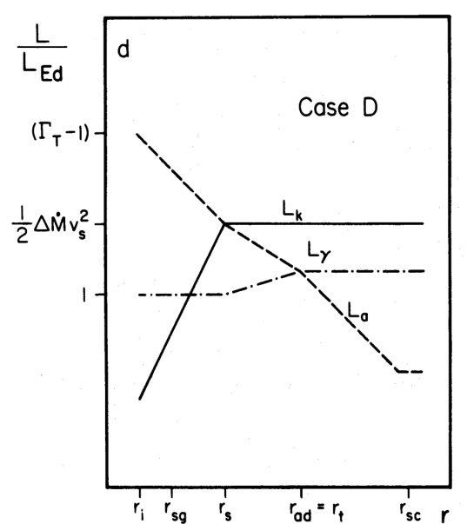
Optically Thick Case D $(r_{s}<r_{ad}<r_{sc})$
The wind is fully accelerated within the adiabatic regime, reaching critical point at $r_{s}$ with terminal velocity $v_{ter}\sim c_{s}⁢\left(r_{s}\right)$
Photon Luminosity
Kinetic Luminosity
Advective Luminosity
These winds also have enormous mass-loss rates, very high ${L_{T}}/{L_{Edd}}$, and even sper-Eddington photon luminosities ($L_{rad}>L_{Edd}$)
 | $$ρ$$ | $$v$$ | $$p$$
$$r<r_{c}$$ | $ρ_{i}⁢{\left(\frac{r}{r_{i}}\right)}^{−3}$ | $v_{i}⁢\left(\frac{r}{r_{i}}\right)$ | $p_{i}⁢{\left(\frac{r}{r_{i}}\right)}^{−4}$
$$r>r_{c}$$ | $ρ_{c}⁢{\left(\frac{r}{r_{c}}\right)}^{−2}$ | $$v_{c}=v_{i}⁢ζ$$ | $p_{c}⁢{\left(\frac{r}{r_{c}}\right)}^{−3}$
$r_{c}{\sim r}_{s} ；v\sim c_{s}=\sqrt{\frac{γp}{ρ}}$
$r_{c}{\sim r}_{s,g} ；v\sim a=\sqrt{\frac{p_{g}}{ρ}}$
r
Adiabatic
$$r_{ad}$$
Radiative

Slide 48
Optically thick Case C1 $(r_{s,g}<r_{ad}<r_{s};r_{ad}<r_{sc})$
For super-Eddington accretion flows onto black holes that produce winds, the strange and interesting Case C is, by far, the most common wind structure. In this case, the critical point is at $r_{ad}$.
Argument:
$r_{c}$ can’t be at $r_{s,g}$ because $r_{s,g}<r_{ad}$ means that the wind would accelerate pass $r_{s,g}$ within the Adiabatic region (which has $r_{c}{\sim r}_{s}$) .
$r_{c}$ can’t be at $r_{s}$ as $r_{ad}<r_{s}$ says that the wind is radiative when it gets to $r_{s}$.
 | $$ρ$$ | $$v$$ | $$p$$
$$r<r_{c}$$ | $ρ_{i}⁢{\left(\frac{r}{r_{i}}\right)}^{−3}$ | $v_{i}⁢\left(\frac{r}{r_{i}}\right)$ | $p_{i}⁢{\left(\frac{r}{r_{i}}\right)}^{−4}$
$$r>r_{c}$$ | $ρ_{c}⁢{\left(\frac{r}{r_{c}}\right)}^{−2}$ | $$v_{c}=v_{i}⁢ζ$$ | $p_{c}⁢{\left(\frac{r}{r_{c}}\right)}^{−3}$
Adiabatic, before critical point
Radiative, passed critical point
$$v∝r$$
$$v\sim const.$$
$$r_{s,g}$$
$$r_{ad}$$
$$r_{s}$$
$r_{c}{\sim r}_{s} ；v\sim c_{s}=\sqrt{\frac{γp}{ρ}}$
$r_{c}{\sim r}_{s,g} ；v\sim a=\sqrt{\frac{p_{g}}{ρ}}$
The critical radius should be somewhere around $r_{ad}!$
r
Adiabatic
$$r_{ad}$$
Radiative

Slide 49
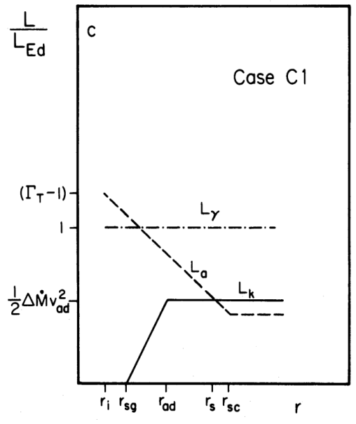
Optically thick Case C1 $(r_{s,g}<r_{ad}<r_{s};r_{ad}<r_{sc})$
Photon Luminosity
Kinetic Luminosity
Advective Luminosity
 | $$ρ$$ | $$v$$ | $$p$$
$$r<r_{c}$$ | $ρ_{i}⁢{\left(\frac{r}{r_{i}}\right)}^{−3}$ | $v_{i}⁢\left(\frac{r}{r_{i}}\right)$ | $p_{i}⁢{\left(\frac{r}{r_{i}}\right)}^{−4}$
$$r>r_{c}$$ | $ρ_{c}⁢{\left(\frac{r}{r_{c}}\right)}^{−2}$ | $$v_{c}=v_{i}⁢ζ$$ | $p_{c}⁢{\left(\frac{r}{r_{c}}\right)}^{−3}$
$r_{c}{\sim r}_{s} ；v\sim c_{s}=\sqrt{\frac{γp}{ρ}}$
$r_{c}{\sim r}_{s,g} ；v\sim a=\sqrt{\frac{p_{g}}{ρ}}$
r
Adiabatic
$$r_{ad}$$
Radiative

Slide 50
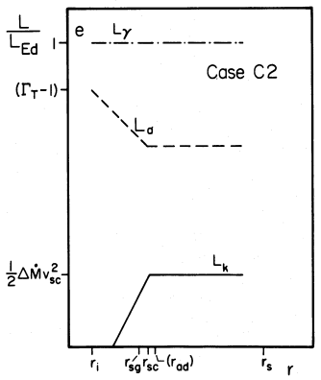
Optically Thick Case C2 $(r_{sg}<r_{sc}<r_{ad}<r_{s})$
 | $$ρ$$ | $$v$$ | $$p$$
$$r<r_{c}$$ | $ρ_{i}⁢{\left(\frac{r}{r_{i}}\right)}^{−3}$ | $v_{i}⁢\left(\frac{r}{r_{i}}\right)$ | $p_{i}⁢{\left(\frac{r}{r_{i}}\right)}^{−4}$
$$r>r_{c}$$ | $ρ_{c}⁢{\left(\frac{r}{r_{c}}\right)}^{−2}$ | $$v_{c}=v_{i}⁢ζ$$ | $p_{c}⁢{\left(\frac{r}{r_{c}}\right)}^{−3}$
$r_{c}{\sim r}_{s} ；v\sim c_{s}=\sqrt{\frac{γp}{ρ}}$
$r_{c}{\sim r}_{s,g} ；v\sim a=\sqrt{\frac{p_{g}}{ρ}}$
r
Adiabatic
$$r_{ad}$$
Radiative

Slide 51
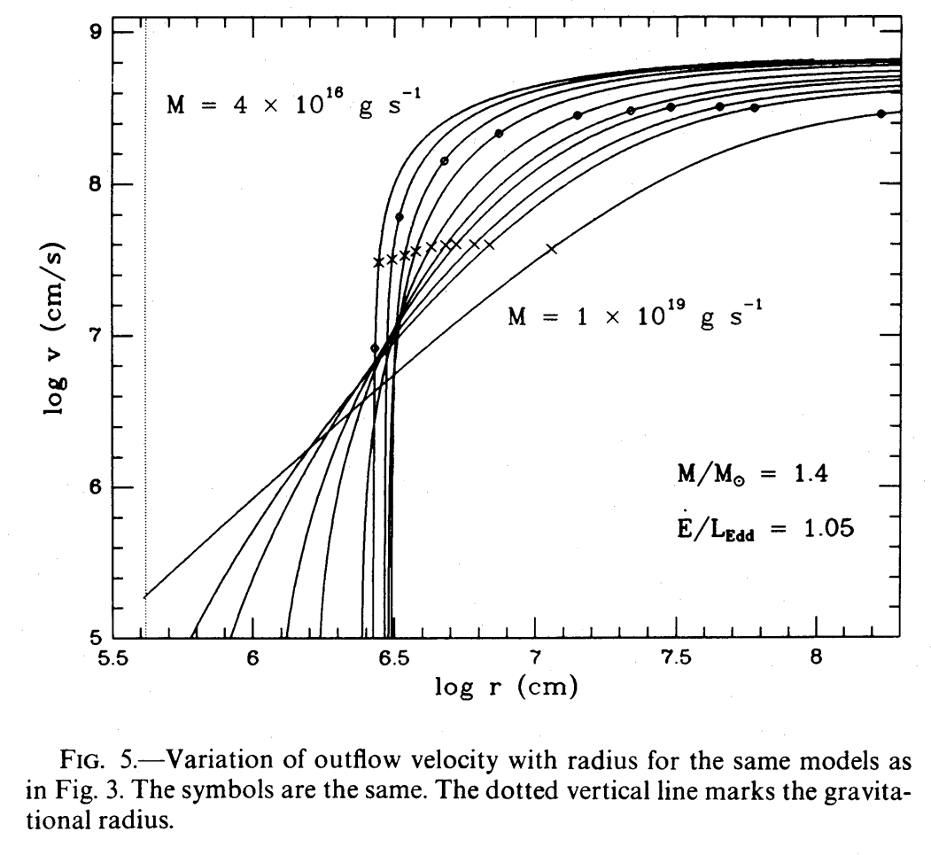
ApJ, 289, 634 (1985)

Slide 52
 | No-wind solution | Super-Eddington wind solution
$$L_{T}$$ | $$ε_{acc}⁢δ⁢\overset{.}{M}⁢c^{2}$$ | $\left(1+\frac{r_{g}}{ε_{acc}⁢r_{i}}⁢\left(\overset{.}{m}−1\right)\right)⁢L_{Edd}=\left(2−\frac{1}{\overset{.}{m}}\right)⁢L_{Edd}$
$$Δ⁢\overset{.}{M}$$ | 0 | $\overset{.}{M}−{\overset{.}{M}}_{Edd}$
$$δ⁢\overset{.}{M}$$ | $$\overset{.}{M}$$ | ${\overset{.}{M}}_{Edd}$
 | $$ρ$$ | $$v$$ | $$p$$
$$r<r_{c}$$ | $ρ_{i}⁢{\left(\frac{r}{r_{i}}\right)}^{−3}$ | $v_{i}⁢\left(\frac{r}{r_{i}}\right)$ | $p_{i}⁢{\left(\frac{r}{r_{i}}\right)}^{−4}$
$$r>r_{c}$$ | $ρ_{c}⁢{\left(\frac{r}{r_{c}}\right)}^{−2}=ρ_{i}⁢ζ^{−3}⁢{\left(\frac{r}{r_{c}}\right)}^{−2}$ | $$v_{c}=v_{i}⁢ζ$$ | $p_{c}⁢{\left(\frac{r}{r_{c}}\right)}^{−3}=p_{i}⁢ζ^{−4}⁢{\left(\frac{r}{r_{c}}\right)}^{−3}$
This was derived for Case C !
$$r<r_{c}$$
$$r>r_{c}$$

Slide 53
Next Week
No Black Hole Astrophysics Report!

